Slide 1
Computational Photography
Xiaowei Deng
Course Advisor: Dr. Shirani
Dec. 10, 2013
Notes:
Good morning, everyone.
My name is Xiaowei Deng. Now I’m going to try my best to share with you what I learnt in these days for the charter 10: about computational photography.
Actually, Computational photography is an emerging field that aims to overcome the limitations of conventional digital imaging and display devices by using computational techniques and novel coded optical devices and sensors to perform more efficient and accurate measurement as well as produce more compelling and meaningful visualizations of the world around us.
It is a convergence of many areas, such as computer vision, computer graphics, image processing, photography, and so on.

Slide 2
Outline
Photometric calibration
High dynamic range imaging
Image matting and compositing
Super-resolution and blur removal
Texture analysis and synthesis
Notes:
In today’s Lecture, I will cover topics of Photometric calibration, High dynamic range imaging, Super-resolution and blur removal, image matting and compositing, Texture analysis and synthesis.

Slide 3
Outline
Photometric calibration
High dynamic range imaging
Image matting and compositing
Super-resolution and blur removal
Texture analysis and synthesis
Notes:
Let’s first start with photometric calibration.

Slide 4
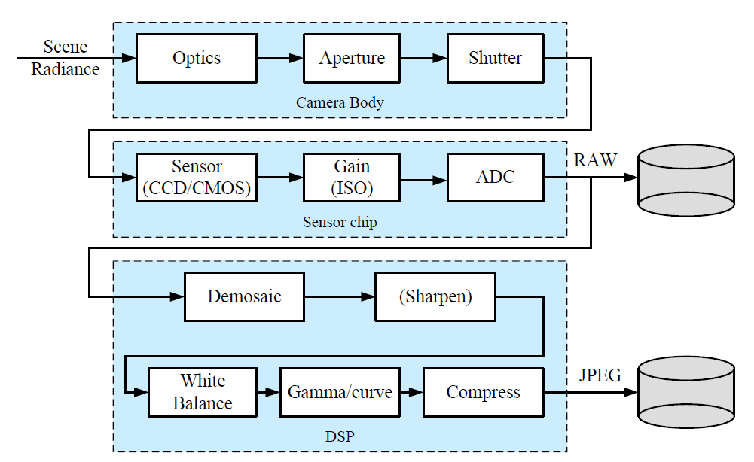
Image sensing pipeline
Photometric calibration
Notes:
Please let me show you a image sensing pipeline first, which give the procedure of how digital image is generated.
Basically, the scene radiance will go through camera body into the sensor chip, and the camera will also do a simple image processing on the raw image data.
And what we need to characterize is the functions that map incoming irradiance and the output pixel values
What else we care for including the amounts of noise present in each image.

Slide 5
Calibration
Photometric calibration
Radiometric response function
Noise level estimation
Notes:
basically, I will focus on two components, the methods for radiometric response function, Noise level estimation

Slide 6
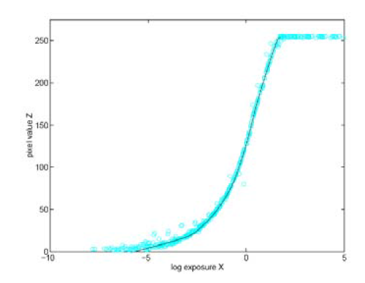
Radiometric response function
Photometric calibration
Affect Factors:
1. Aperture and shutter speed
2. A/D converter (controlled by ISO, linear)
3. Demosaicing
Notes:
This is how A typical radiometric response function looks like :
The x axis shows the exposure values, which usually in log 2 ratios, the Y axis shows the pixel values Z, most times, like in RGB channel, ranges from 0 – 255.
There are many factors that will affect the function. Basically, there are 3 things here:….
As you can see, it is very hard to model the camera response function, that is the mapping between incoming irradiance and digital RGB values.
So next, I’m going to show you some practical approaches to calibrate the camera by measuring the correspondences between incoming light and final values.

Slide 7
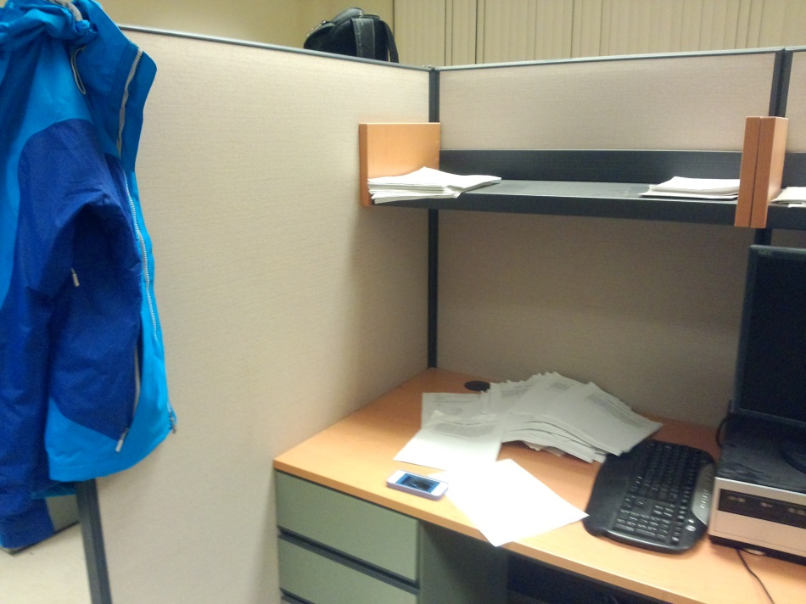
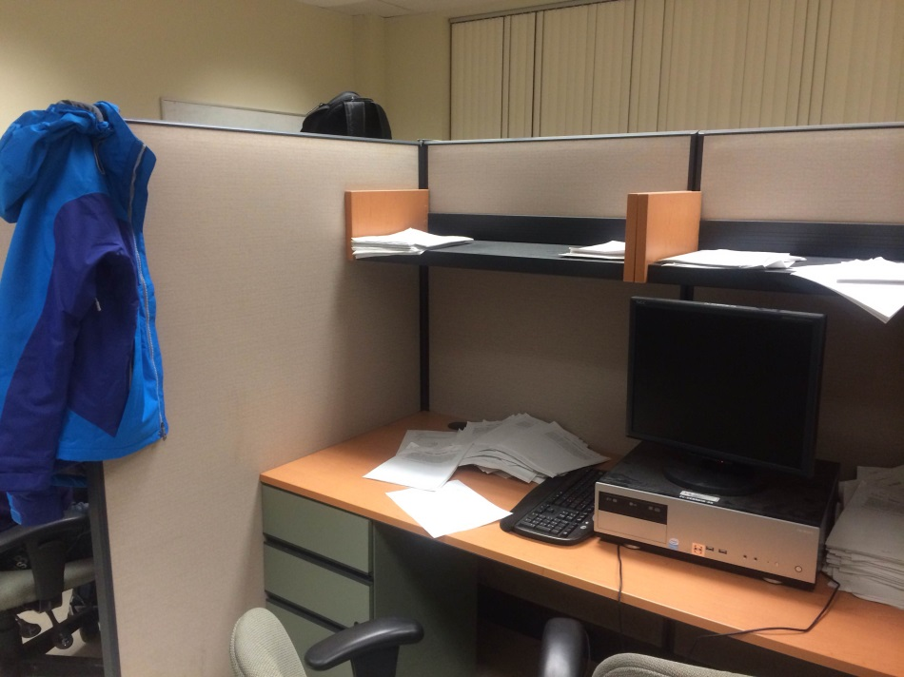
Why calibrate
Photometric calibration
Using Samsung Phone
Using iPhone
Notes:
By the way, I want to give you simple intuition for why we should do calibration.
Here I took two pictures in the same place using two different devices, we can see that there is a color difference here: the picture on the right is kind of more red.
And if we focus on here: we can see that we on the left, we cannot see the edge of the paper. This is also a specific name for this issue called High dynamic range imaging. Which I will talk to you later.

Slide 8
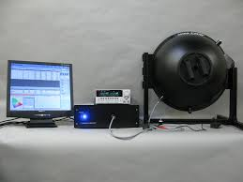
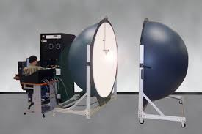
Approaches to measure response function
Photometric calibration
Integrating sphere
Notes:
The most accurate, but also most expensive way in to use an integrating sphere.
A typical sphere is a large one, the inside painted with white matte paint.
This device can make the irradiance constant everywhere inside the sphere, and we can accurately control the light exposure.
There is a small opening at the side can allows for a camera combination to be mounted as well.
In this way , we can establish the response between incoming radiance and measured pixel values.

Slide 9
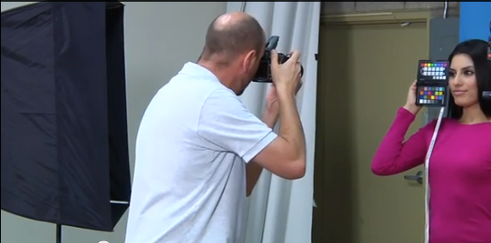
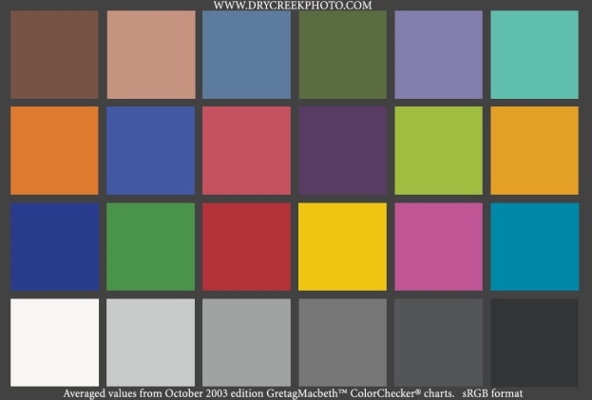
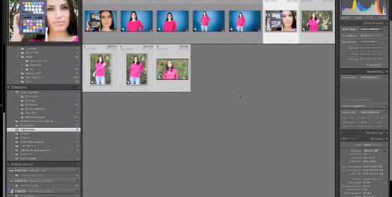
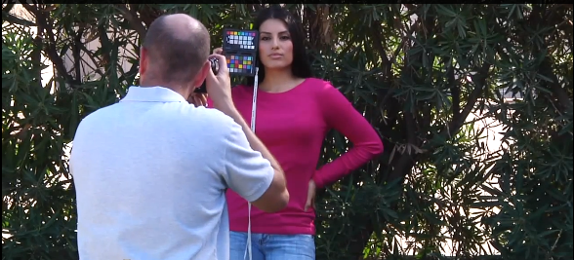
Approaches to measure response function
Photometric calibration
Calibration chart
http://www.adorama.com/alc/0013301/article/Using-the-ColorChecker-Passport-Adorama-TV
Notes:
There is another way, which is more practical, to measure response, is to use calibration chart.
Actually, when using this method, you have to carry the colorchecker chart to shoot in the same lighting as your images;
And Then you can use a photo processing software, like photoshop, to deal with color correction.
What you’re going to notice is that this approach must ensure uniform lighting. So do not place the chart under shadows.
Here is the website, gives a video tutorial on how to use the chart.
So if you are a Photography lovers, you can use this way to generate a more realistic, higher quality photographs .

Slide 10
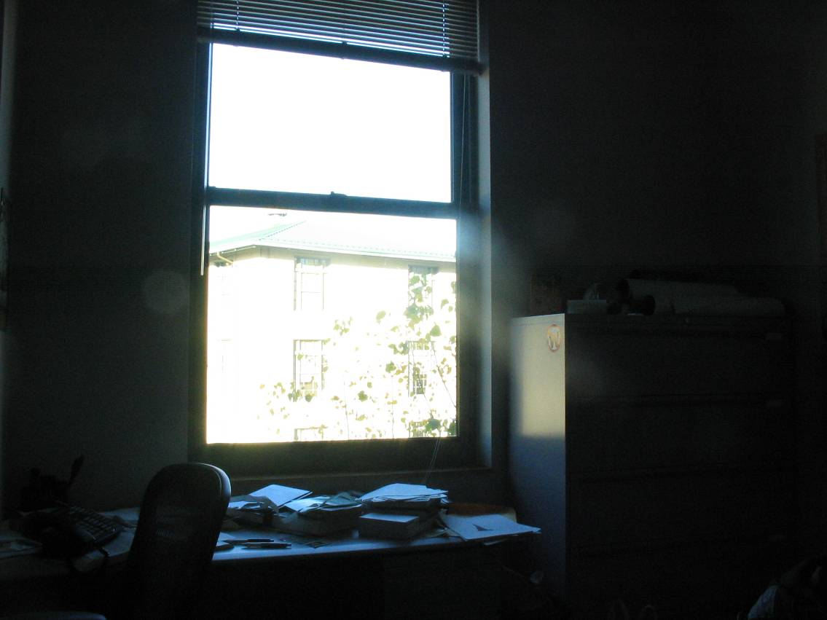
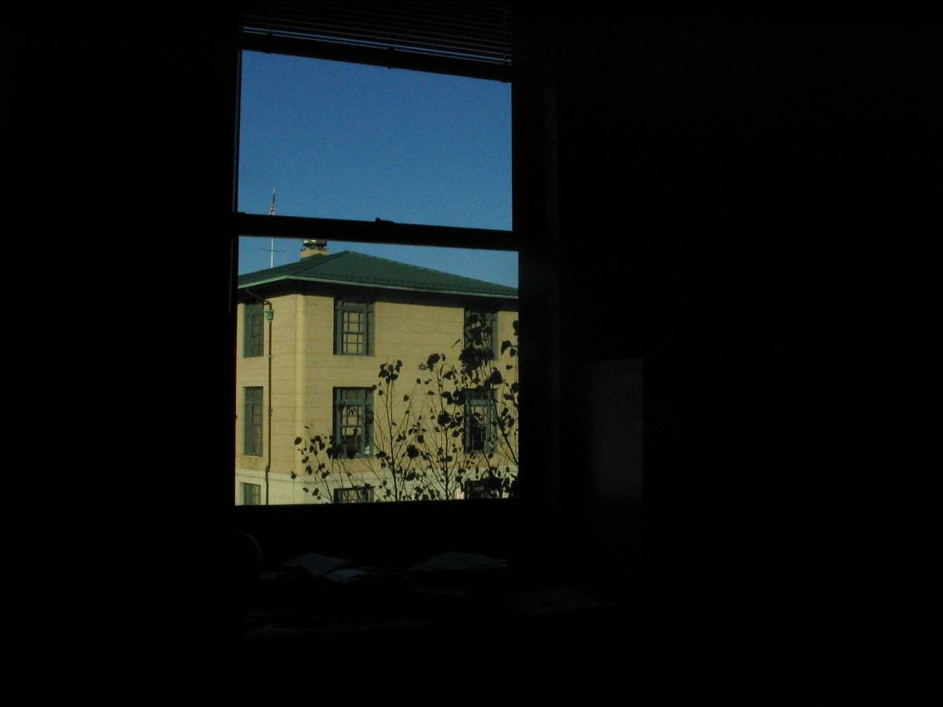
Approaches to measure response function
Photometric calibration
Multiple images’ algorithms
Notes:
Actually, there is another way to use multiple images to calculate the response function, which is widely used in HDR image processing.
It is like you have more than one images, you can use these information to reconstruct the response function.
I think I’ll cove the detail algorithms later.

Slide 11
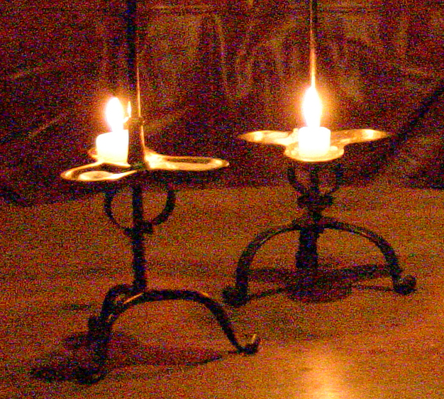
Noise level estimation
Photometric calibration
Notes:
another important thing, I’m going to tell you, is noise level estimation,
When you shoot a picture, especially there is no enough light, you camera will generate noises everywhere.
The question is how to xiaochudetect these noise and Eliminate the noise here.

Slide 12
Approaches to measure noise
Photometric calibration
Integrating sphere
Calibration chart
Taking repeated exposures and computing the variance(Healey and Kondepudy 1994)
Assuming pixel values should all be the same within some region.(Liu, Szeliski, Kang et al.2008)

Slide 13
Approaches to measure noise
Photometric calibration
Integrating sphere
Calibration chart
Taking repeated exposures and computing the variance(Healey and Kondepudy 1994)
Assuming pixel values should all be the same within some region.(Liu, Szeliski, Kang et al.2008)

Slide 14
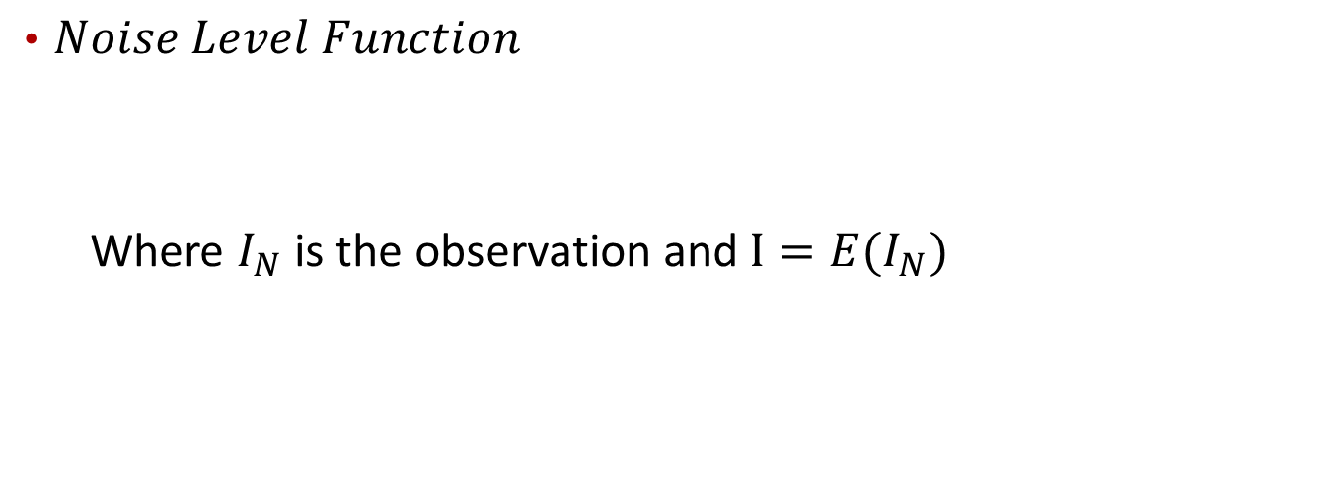
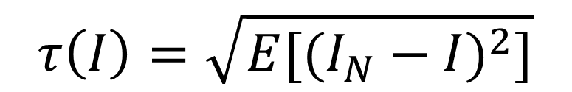
Noise Estimation from a Single Image(Liu,2008)
Photometric calibration
$Noise Level Function$
Where $I_{N}$ is the observation and $I=E(I_{N})$
$$τ\left(I\right)=\sqrt{E[{(I_{N}−I)}^{2}]}$$
Notes:
In his paper, He defines the noise level function(NLF) as the variation of the standard deviation of noise with respect to image intensity.
Basically, or Essentially, this is a function of how standard deviation changes with respect to the mean value.
And Our goal is to infer this function.

Slide 15
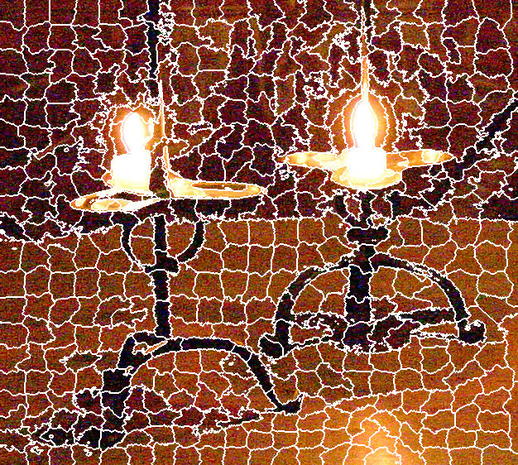
Step 1. Segmentation
Photometric calibration
Step 1.
Segment the image in to regions and fit a constant or linear function inside each region

Slide 16



Step 2. Measure deviation
Photometric calibration
Affine model
=
+
Patch
Signal
Residual
For each RGB channel:
Brightness mean I
Standard deviation σ
σ
Red
σ
Green
σ
Blue
0.2
0.2
0.2
Standard deviation
0.1
0.1
0.1
0
I
0
I
0
I
0 0.5 1
0 0.5 1
0 0.5 1
Brightness
Notes:
The idea of Liu’s paper in 2008 is like this.
He assume that there are regions of constant or slowly varying intensity to photos .

Slide 17
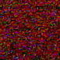


Step 2. Measure deviation
Photometric calibration
=
+
Patch
Signal
Residual
σ
Red
σ
Green
σ
Blue
0.2
0.2
0.2
Standard deviation
0.1
0.1
0.1
0
I
0
I
0
I
0 0.5 1
0 0.5 1
0 0.5 1
Brightness

Slide 18


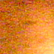
Step 2. Measure deviation
Photometric calibration
=
+
Patch
Signal
Residual
σ
Red
σ
Green
σ
Blue
0.2
0.2
0.2
Standard deviation
0.1
0.1
0.1
0
I
0
I
0
I
0 0.5 1
0 0.5 1
0 0.5 1
Brightness

Slide 19
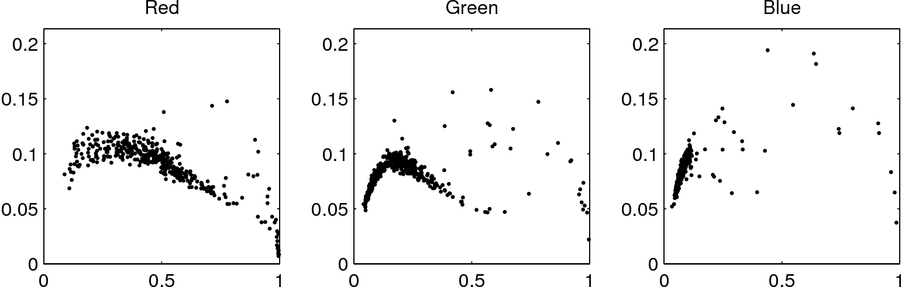
Step 3. Fit a lower envelope
Photometric calibration
σ
σ
σ
Residual std. dev.
I
I
I
Brightness
Assume brightness mean I is accurate estimate
Standard deviation σ is an over-estimate: (may contain signal)
The lower envelope is the upper bound of NLF

Slide 20
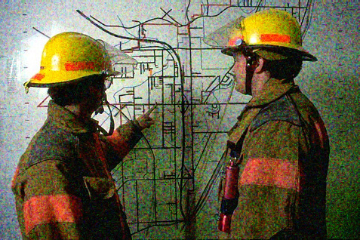
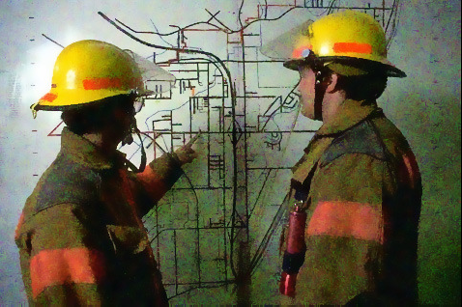
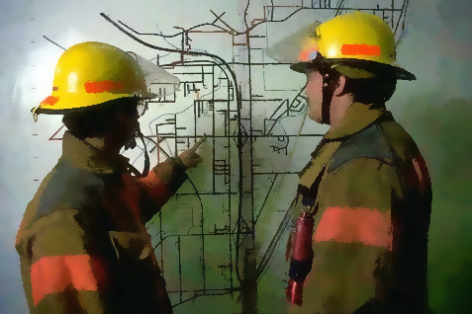
Noise Estimation from a Single Image(Liu,2008)
Photometric calibration
Results
Using standard bilateral filter
Using adaptive bilateral filter(para by deviation of the noise)

Slide 21
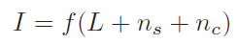
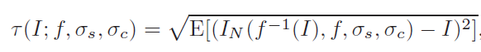
Noise Estimation from a Single Image(Liu,2008)
Photometric calibration
CCD camera noise model:
Noise level function:
Notes:
Step 2:The Prior of NLFs
before we infer the NLF, we can get a prior of NLF.
Actually, because we know that CCD camera noise model is like this,
dairu our NLF , we can get the new noise level function:

Slide 22
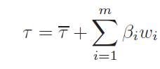
Noise Estimation from a Single Image(Liu,2008)
Photometric calibration
Noise level function:
Using numerical simulation, the noise function, for each of red, green and blue channels, we can get:
Notes:
So our goal is try to infer the actually coefficients on the eigenvectors:
Beta1 2 3 …

Slide 23
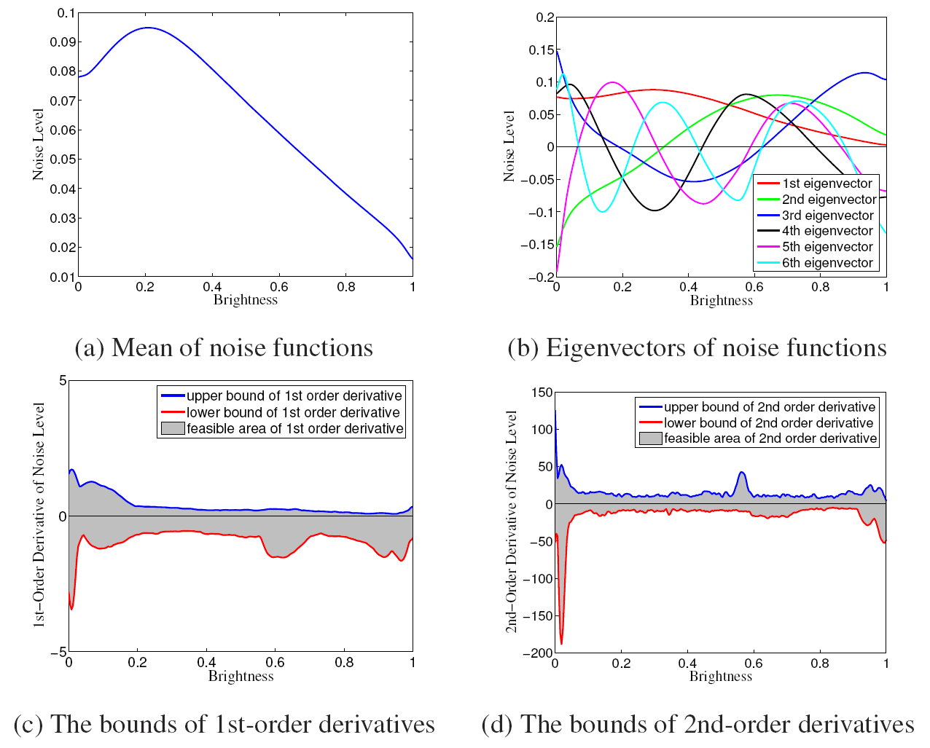
The Prior of NLFs
Photometric calibration

Slide 24
Likelihood Function
Photometric calibration
The estimated standard deviation should be probabilistically bigger than and close to the true value
Bayesian MAP inference
I

Slide 25
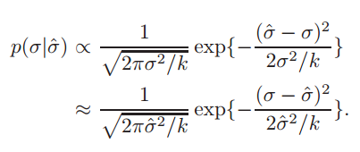
Noise Estimation from a Single Image(Liu,2008)
Photometric calibration
Likelihood model
Notes:
Step 3: Likelihood Model

Slide 26
Noise Estimation from a Single Image(Liu,2008)
Photometric calibration
Bayesian MAP Inference

Slide 27
Outline
Photometric calibration
High dynamic range imaging
Super-resolution and blur removal
Image matting and compositing
Texture analysis and synthesis
Notes:
The next part I’m going to show you is the High dynamic range imaging.

Slide 28
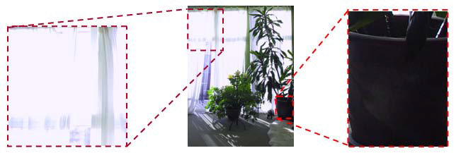
High Dynamic Range
High dynamic range imaging
Notes:
And in my later lecture for high dynamic range imaging, I will show you how to use a algorithm to calculate the function.
The second topic which I want to show you is so called high-dynamic range image processing.
What is high dynamic range actually? In the pic, we can see that some parts are overexposed while some parts are underexposed. We can can not see all the details for the whole picture.
the areas outside the window are overexposed and inside the room are too dark, or we can say that is underexposed.

Slide 29
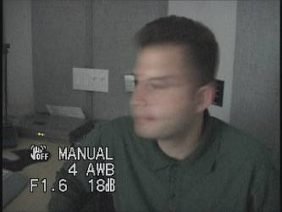
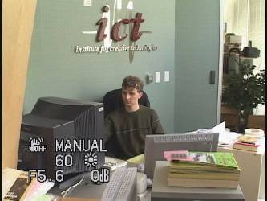
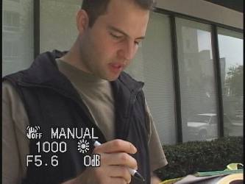
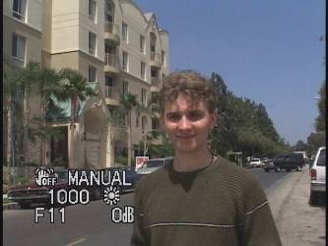
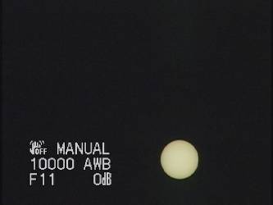
The Problem of Dynamic Range
High dynamic range imaging
1
The real world is high dynamic range!
1500
25,000
400,000
200,000,000
Notes:
Unfortunally, the problems are very common. The dynamic range ratio for the real word could be as high as like 200 million.

Slide 30
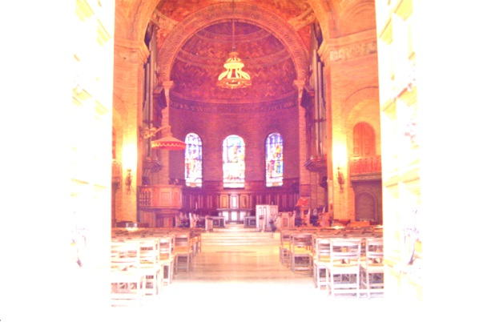
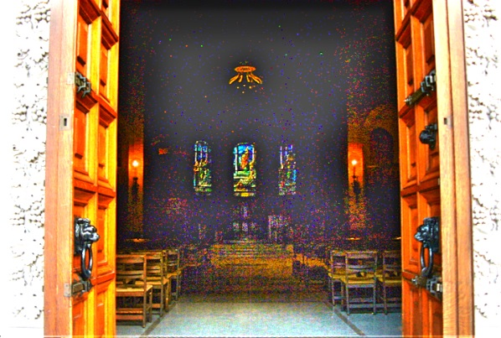
High dynamic range imaging
10⁻⁶
High dynamic range
10⁶
Real world
Long Exposure
10⁻⁶
Short Exposure
10⁶
Picture
^{0 to 255}
Today’s Cameras: Limited Dynamic Range
High Exposure Image
Low Exposure Image
We need about 5-10 million values to store all brightnesses around us.
But, typical 8-bit cameras provide only 256 values!!
Notes:
The problem is like,
If you shoot a very bright thing, like the sun in the sky, you have to use a very short exposure time. But if you want to shoot the star or moon at light, you have to use long exposure.
But the realistic scenario has more that 5 million values of brightness, and our camera can only provide 256 values..
Basically, we should have a special non-linear mapping function to regenerate a better view picture.

Slide 31
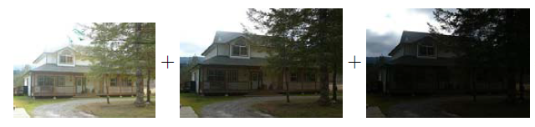
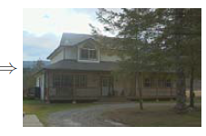
AEB mode and HDR Composite
High dynamic range imaging
Notes:
Actually, we can take a set of bracketed exposures images by using camera’s automatic exposure bracketing mode.
Obviously, These three pics are using over-exposure, normal exposure, under-exposure.
If we combine them together using some techniques, we can get a relatively better one.

Slide 32
Recovering HDR
High dynamic range imaging
1. Extract the radiance information from the photographs
2. Tone-map it into a single low dynamic range image
Notes:
Basically, we have 2 steps to generate a better composition picture.
To turn a photograph into an HDR image, we first extract the radiance information from the photographs and then tone-map it into a single low dynamic range image.

Slide 33
Recovering HDR
High dynamic range imaging
1. Extract the radiance information from the photographs
2. Tone-map it into a single low dynamic range image
Notes:
Basically, we have 2 steps to generate a better composition picture.
To turn a photograph into an HDR image, we first extract the radiance information from the photographs and then tone-map it into a single low dynamic range image.

Slide 34
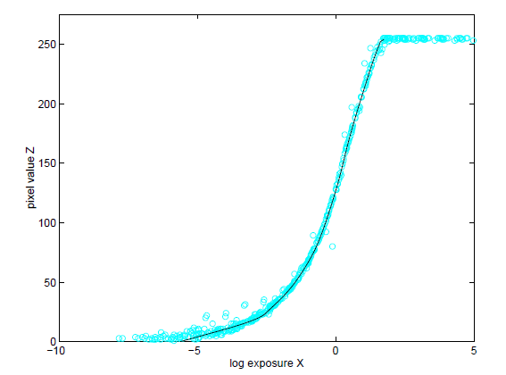
Recover radiance map (Debevec. 1997)
High dynamic range imaging
Given multiple exposure pictures
Goal: estimating the radiometric response function( radiance map )
Notes:
For the first step, to estimate the radiance map, I’m going to show you the algorithms proposed by Debevec@1997. It is very simple but affective method.

Slide 35
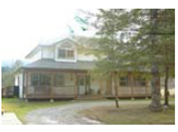
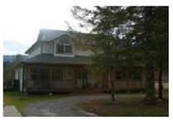
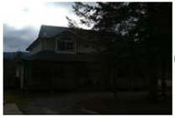
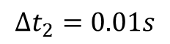
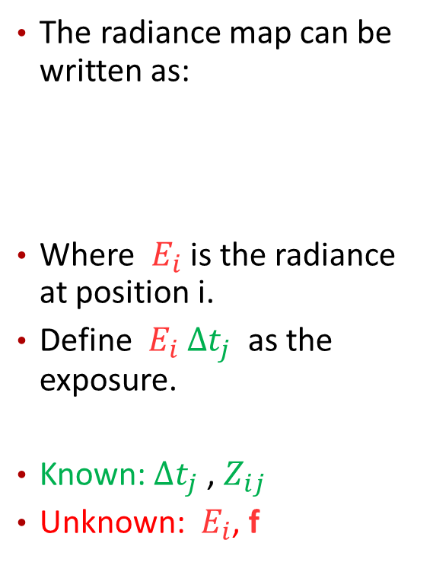
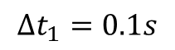
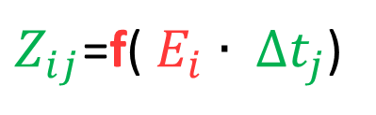
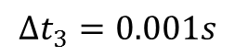
Recover radiance map (Debevec. 1997)
High dynamic range imaging
At Position i
The radiance map can be written as:
Where ${ E}_{i}$ is the radiance at position i.
Define ${ E}_{i}$ $∆t_{j}$ as the exposure.
Known: $∆t_{j}$ , $Z_{ij}$
Unknown: ${ E}_{i}$, f
$$∆t_{1}=0.1s$$
$Z_{ij}$=f(${ E}_{i}$ $∙ ∆t_{j}$)
$$∆t_{2}=0.01s$$
$$∆t_{3}=0.001s$$
Notes:
Before we get started with the math, I should show you what’s going on here when we use camera to take pictures with different exposure.
We can see that for a static scenario, if we take different exposure pictures, we can get 3 different values at the same position.
The mapping function between the exposure and image value are function f.
We want to recover the function f and the irradiances Ei that best satisfy the set of equations arising from this equation.
Here we suppose that we know the exposure time t for each picture,

Slide 36

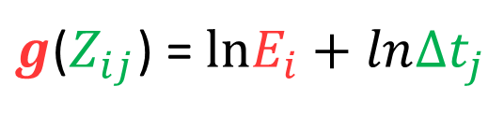
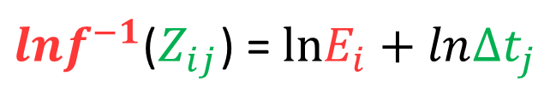
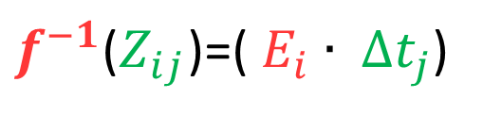
Recover radiance map (Debevec. 1997)
High dynamic range imaging
$Z_{ij}$=f(${ E}_{i}$ $∙ ∆t_{j}$)
can be rewrite as:
$f^{−1}$($Z_{ij}$)=(${ E}_{i}$ $∙ ∆t_{j}$)
, taking the natural logarithm of both sides, we have:
${lnf}^{−1}$($Z_{ij}$) = $lnE_{i}$ $+ ln∆t_{j}$
, to simplify notation, let g=f⁻¹
$g$($Z_{ij}$) = $lnE_{i}$ $+ ln∆t_{j}$
Note: recovering g only requires recovering finite number of values.( Since the domain of Z is from 0-255)

Slide 37
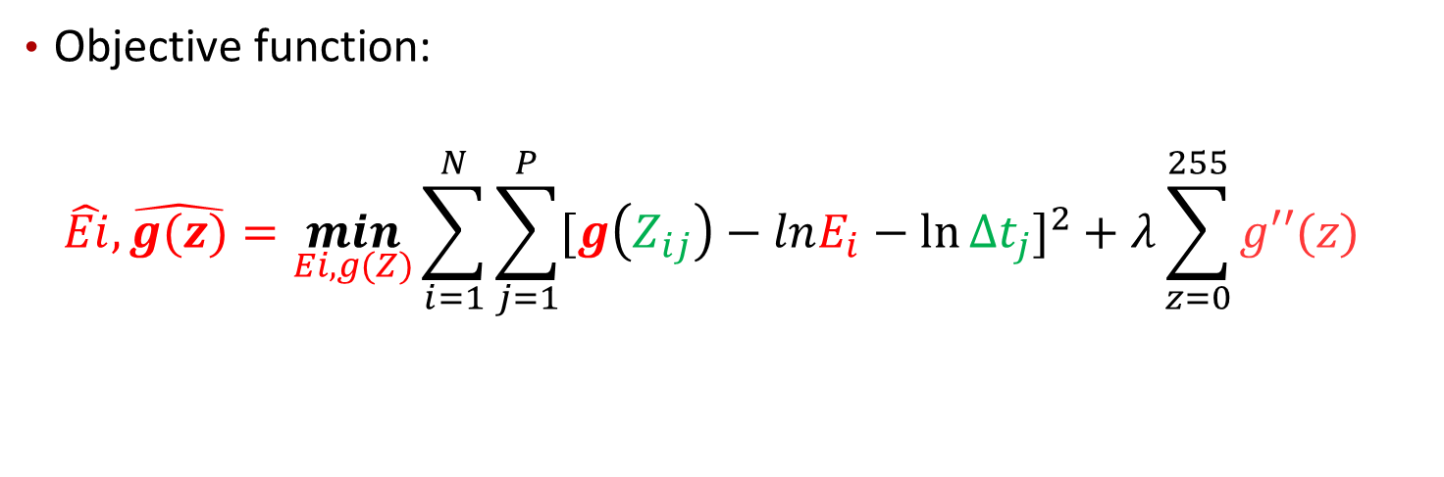
Recover radiance map (Debevec. 1997)
High dynamic range imaging
Objective function:
$$\hat{Ei},\hat{g(z)}=\min_{Ei, g(Z)}{\sum_{i=1}^{N}{\sum_{j=1}^{P}{{[g\left(Z_{ij}\right)−lnE_{i}−\ln{{∆t}_{j}}]}^{2}}}+λ\sum_{z=0}^{255}{g′′(z)} }$$
Notes:
So apparently, we can come up with this following quadratic objective function:

Slide 38



Recover radiance map (Debevec. 1997)
High dynamic range imaging
Refine objective function:
1. scalar function:
2. anticipating the basic shape of the response function:
Notes:
First, we should have a scalar function here. Because you can see that if we put lnEi as lnEi+constant, and function g plus a constant, the objective function would remain unchanged. So we should introduce the additional constraint function.
Sencondly, because we know the basic shape of the response function: the g(z) will typically have a steep slope near 0 and 255 so we introduce a weighting function here.
This weigting func means that near edge of domain the curve could be very slope.

Slide 39

Recover radiance map (Debevec. 1997)
High dynamic range imaging
Refine objective function:
3. How many samples(pixels) do we need to calculate:
$$\hat{Ei},\hat{g(z)}=\min_{Ei, g(Z)}{\sum_{i=1}^{N}{\sum_{j=1}^{P}{{[g\left(Z_{ij}\right)−lnE_{i}−\ln{{∆t}_{j}}]}^{2}}}+λ\sum_{z=0}^{255}{g′′(z)} }$$
1.Make sure (# of Ei)*(# of Pictures)>256
2.The pixel locations should be chosen so that they have a reasonably even distribution of pixel values.
Notes:
Mathematically, we have to solve for N valudes of Ei in P photographs, and 256 value of pixels. To ensure a sufficient overdetermined system, we need N*P> 256

Slide 40

Recover radiance map (Debevec. 1997)
High dynamic range imaging
Matix representation
Notes:
Actually, if we use matrix representation, it is like this:

Slide 41
MATLAB CODE
High dynamic range imaging
function [g,lE]=gsolve(Z,B,l,w)
n = 256;
A = zeros(size(Z,1)*size(Z,2)+n+1,n+size(Z,1));
b = zeros(size(A,1),1);
k = 1; %% Include the data-fitting equations
for i=1:size(Z,1)
for j=1:size(Z,2)
wij = w(Z(i,j)+1);
A(k,Z(i,j)+1) = wij; A(k,n+i) = -wij; b(k,1) = wij * B(i,j);
k=k+1;
end
end
A(k,129) = 1; %% Fix the curve by setting its middle value to 0
k=k+1;
for i=1:n-2 %% Include the smoothness equations
A(k,i)=l*w(i+1); A(k,i+1)=-2*l*w(i+1); A(k,i+2)=l*w(i+1);
k=k+1;
end
x = A\b; %% Solve the system using SVD
g = x(1:n);
lE = x(n+1:size(x,1));
20 lines !

Slide 42

Recover radiance map (Debevec. 1997)
High dynamic range imaging
Constructing the HDR Radiance Map

Slide 43

Results: Color Film
High dynamic range imaging
Kodak Gold ASA 100, PhotoCD
Notes:
14

Slide 44

Recovered Response Curves
High dynamic range imaging
Red
Green
Blue
RGB
Notes:
15

Slide 45


The Radiance Map
High dynamic range imaging
Notes:
17

Slide 46
Recovering HDR
High dynamic range imaging
1. Extract the radiance information from the photographs
2. Tone-map it into a single low dynamic range image
Notes:
Basically, we have 2 steps to generate a better composition picture.
To turn a photograph into an HDR image, we first extract the radiance information from the photographs and then tone-map it into a single low dynamic range image.

Slide 47
High dynamic range imaging
10⁻⁶
High dynamic range
10⁶
Real world
10⁻⁶
10⁶
Picture
^{0 to 255}
Given radiance map
Goal: build a reasonable mapping function of radiance to pixel values

Slide 48



Tone mapping Methods
High dynamic range imaging
Simple Gamma tone mapping
Gamma applied to each color channel independently
Input Image
Gamma compression
Gamma applied to each channel
Notes:
Gamma compression)

Slide 49

Tone mapping Methods
High dynamic range imaging
Intensity Gamma tone mapping
Splitting the image up into luminance and chrominance(L*a*b) components, and applying the mapping to the luminance channel
Input Image
Gamma applied to luminance
Notes:
Obviously, this way works better!

Slide 50



Chrominance and luminance
High dynamic range imaging
YUV color space
Notes:
By the way, I think I have to show the basic conception of chrominance and luminance. Basically, it is another representation for color image. This is also called YUV color space. It is widely used on Television.
On the right side of our slide, we can see that this is a example of YUV color space. The top picture is represent in RGB value. The following pics are luminace part, and 2 chrominance part.

Slide 51

Tone mapping Methods
High dynamic range imaging
Advanced mapping method
Notes:
Unfortunately, when image has a really wide range of exposures, this global approach still fails to preserve details in regions with widely varying exposures.

Slide 52

Tone mapping Methods
High dynamic range imaging
Advanced mapping method (using Edge-preserving filter)

Slide 53
Outline
Photometric calibration
High dynamic range imaging
Image matting and compositing
Super-resolution and blur removal
Texture analysis and synthesis
Notes:
In this Lecture, I will show you many interesting, recent techniques for capturing, modeling, and displaying of complex appearance phenomena.
I will cover topics of Photometric calibration, High dynamic range imaging, Super-resolution and blur removal, image matting and compositing, Texture analysis and synthesis.

Slide 54

Image matting and compositing
Image matting and compositing
Notes:
Actually, Image matting is commonly used in television and film production to composite a live actor in front of computer-generated image.
Or we can say, by using matting Power, super-man is able to fly everywhere. ☺

Slide 55

Compositing Equation
Image matting and compositing
$C=\left(1−α\right)B+α$F
B: background image
F: foreground image
C: composite image
Notes:
We first look at how compositing is done.
Basically, in the model, we use background, foreground, and alpha channel to describe this problem.
As show in the equation, this operator attenuates the influence of the background image B by a factor (1-alpha) and adds in the color values corresponding to the foreground element F.
During composting, given a foreground element including the foregound color F and an opacity image called alpha matte, and the background B, the composte C is computed by the composting equation shown here.

Slide 56






Image matting and compositing
foreground color
alpha matte
background plate
F
α
B
composite
C
F
$C=\left(1−α\right)B+α$F
C
compositing
equation
α=0
B
Notes:
Here is the example.
We can see that, by using this technique, we can …..
Here, alpha matte acts like a switch to select foregound if it is white, background if it is black.
Most importantly, it is soft around the boundaries. The fractional alpha describe how much foreground and how much background should be taken. A soft alpha matte is very important for seamless composite.

Slide 57


Compositing
Image matting and compositing
Alpha
1: means opaque,
0:means transparent
Fractional alpha is important!
With
binary
alpha
With
fractional
alpha
Notes:
Most importantly, it is soft around the boundaries. The fractional alpha describe how much foreground and how much background should be taken. A soft alpha matte is very important for seamless composite.
We can see that, if we use binary alpha, the boundary is not smooth. Which makes the picture not that realistic.
Motion blur, small features (hair) cause partial
Occlusion
But How to get a reasonable alpha , usually we will use the technique of matting.!

Slide 58

Matting
Image matting and compositing
Matting
F
α
B
C
compositing
equation
Notes:
While, Matting is an inverse process to compositing. Given the observation C, essentially the composite, based on the compositing equation, we attempt to estimate the foreground color, the alpha matte and the background color. Which is far more challenging.
It is an under-costained problem, we have to solve 7 unknowns from 3 equations.

Slide 59



Matting ambiguity
Image matting and compositing
$C=\left(1−α\right)B+α$F
Known: C
Unknown: $α$, $B,$F
7 unknowns: α and triplets for F and B
3 equations, one per color channel
Notes:
For matting problems, we only know Current picture.
we have to solve 7 unknowns from 3 equations

Slide 60





Blue screen matting
Image matting and compositing
F
α
$C=\left(1−α\right)B+α$F
C
B
Known: C, $B$
Unknown: $α,$F
4 unknowns: α and triplets for F
3 equations, one per color channel
Notes:
Most times, we use a blue screen matting technique to reduce the number of unknowns.
Blue screen matting means filming an actor in front of a constant colored background.

Slide 61

Traditional blue screen matting
Image matting and compositing
Assume that blue b and green g channels of the foreground respect $b≤a_{2}∙g$
For $a_{2}$ typically between 0.5 and 1.5
$α=1−a_{1}(b−a_{2}g)$
where $a_{1}{,a}_{2}$are user parameters
Lots of refinements (see Smith & Blinn's paper)

Slide 62


Blue screen matting issues
Image matting and compositing
Color limitation
– Annoying for blue-eyed people
adapt screen color (in particular green)
Shadows
– How to extract shadows cast on background

Slide 63





Natural image matting
Image matting and compositing
F
α
B
C
B
BG
FG
unknown

Slide 64

Bayesian matting approach(Chuang 2001)
Image matting and compositing
Given an input image with arbitrary background
The user specifies a coarse Trimap
(known Foreground, known background
and unknown region)
Goal: Estimate F, B, alpha in the unknown region

Slide 65

Bayesian matting approach(Chuang 2001)
Image matting and compositing
Bayes theorem
Notes:
First let’s get a review of bayes theorem.

Slide 66

Bayesian matting approach(Chuang 2001)
Image matting and compositing
Notes:
Given F, B and Alpha, probability that we observe C

Slide 67


Bayesian matting approach(Chuang 2001)
Image matting and compositing
We must try to build a probability distribution for the unknown regions.
$$max L\left(F,B,α | C\right)=max L\left(C | F,B,α\right)+L\left(F,B,α\right)−L(C)$$
$$=max L\left(C | F,B,α\right)+L(F,B,α)$$
$$=max L\left(C | F,B,α\right)+L\left(F\right)+L\left(B\right)+L(α)$$

Slide 68

Bayesian matting approach(Chuang 2001)
Image matting and compositing
Log likelihood $L\left(C | F,B,α\right)$
$$L\left(C | F,B,α\right)=−{\left\|C−αF−\left(1−α\right)B\right\| }^{2}/{σ }^{2}$$
Notes:
This model suppose that the noise is respect to gaussian noise model.

Slide 69



Bayesian matting approach(Chuang 2001)
Image matting and compositing
Prior probabilities $L\left(F\right), L\left(B\right)$
$$L\left(F\right)=−{\left(F−\overline{F}\right) }^{T}{Σ_{F}^{}}^{−1} \left(F−\overline{F}\right)/2$$
SAME for B
Notes:
Fror the prior probabilities, we suppose within each pixel’s neighborhood N, it is a elliptical Gaussian distribution.

Slide 70

Bayesian matting approach(Chuang 2001)
Image matting and compositing
Prior probabilities $L\left(α\right)$
In this work, we assume that log likelihood for the opacity $L\left(α\right)$ is constant.
Ignort it.

Slide 71



Bayesian matting approach(Chuang 2001)
Image matting and compositing
$$max L\left(F,B,α | C\right)$$
$$=max L\left(C | F,B,α\right)+L\left(F\right)+L\left(B\right)$$
$$L\left(C | F,B,α\right)=−{\left\|C−αF−\left(1−α\right)B\right\| }^{2}/{σ }^{2}$$
$$L\left(F\right)=−{\left(F−\overline{F}\right) }^{T}{Σ_{F}^{}}^{−1} \left(F−\overline{F}\right)/2$$
$$L\left(B\right)=−{\left(B−\overline{B}\right) }^{T}{Σ_{B}^{}}^{−1} \left(B−\overline{B}\right)/2$$

Slide 72


Bayesian matting approach(Chuang 2001)
Image matting and compositing
Solve math problem: (for $α$ constant)

Slide 73


Bayesian matting approach(Chuang 2001)
Image matting and compositing
Solve math problem: for $F\&B$ constant

Slide 74
Bayesian matting approach(Chuang 2001)
Image matting and compositing
Solve math problem:
1. The user specifies a trimap
2. Compute Gaussian distributions for foreground and background regions
3. Iterate
– Keep α constant, solve for F & B (for each pixel)
– Keep F & B constant, solve for α (for each pixel)
Note that pixels are treated independently

Slide 75

Bayesian matting approach(Chuang 2001)
Image matting and compositing
Results:

Slide 76
Outline
Photometric calibration
High dynamic range imaging
Image matting and compositing
Super-resolution and blur removal
Texture analysis and synthesis
Notes:
In this Lecture, I will show you many interesting, recent techniques for capturing, modeling, and displaying of complex appearance phenomena.
I will cover topics of Photometric calibration, High dynamic range imaging, Super-resolution and blur removal, image matting and compositing, Texture analysis and synthesis.

Slide 77
How to increase resolution
Image matting and compositing
Possible ways for increasing an image resolution:
– Reducing pixel size.
– Increase the chip-size.
– Super-resolution.

Slide 78
How to increase resolution
Image matting and compositing
Reduce pixel size:
Increase the number of pixels per unit area.
Advantage:
Increases spatial resolution.
Disadvantage:
Noise introduced.
As the pixel size decreases, the amount of light decreases.

Slide 79
How to increase resolution
Image matting and compositing
Increase the chip size (HW):
Advantage:
Enhances spatial resolution.
Disadvantage:
High cost for high precision optics.

Slide 80
How to increase resolution
Image matting and compositing
Superresolution (SR):
Process of combining multiple low resolution images to form a high resolution image.
Advantages:
Cost less than comparable approaches.
LR imaging systems can still be utilized.

Slide 81

Super-resolution
Super-resolution and blur removal
Obtaining a HR image from one or multiple LR images .

Slide 82

Super-resolution

Slide 83
Outline
Photometric calibration
High dynamic range imaging
Image matting and compositing
Super-resolution and blur removal
Texture analysis and synthesis
Notes:
In this Lecture, I will show you many interesting, recent techniques for capturing, modeling, and displaying of complex appearance phenomena.
I will cover topics of Photometric calibration, High dynamic range imaging, Super-resolution and blur removal, image matting and compositing, Texture analysis and synthesis.

Slide 84
Texture analysis and synthesis

Slide 85
Reference
Texture analysis and synthesis
[1]Richard Szeliski,Computer Vision:Algorithms and Applications
[2]Chuang, Y. Y., Curless, B., Salesin, D. H., & Szeliski, R. (2001). A bayesian approach to digital matting. In Computer Vision and Pattern Recognition, 2001. CVPR 2001. Proceedings of the 2001 IEEE Computer Society Conference on(Vol. 2, pp. II-264). IEEE.
[3] Liu, C., Freeman, W. T., Szeliski, R., & Kang, S. B. (2006, June). Noise estimation from a single image. In Computer Vision and Pattern Recognition, 2006 IEEE Computer Society Conference on (Vol. 1, pp. 901-908). IEEE.
[4] Kim, S. J., & Pollefeys, M. (2008). Robust radiometric calibration and vignetting correction. Pattern Analysis and Machine Intelligence, IEEE Transactions on, 30(4), 562-576.
[5] Debevec, P. E., & Malik, J. (2008, August). Recovering high dynamic range radiance maps from photographs. In ACM SIGGRAPH 2008 classes (p. 31). ACM.

Slide 86

Thanks!
Seminar on computational photography
Course advisor: Dr. Shirani
Web: http://sdfsfalkfjasdlfj
Email: dengx23@mcmaster.ca
Xiaowei Deng @Mac, Dec. 2013

